Slide 1


Errors & Threats

Slide 2
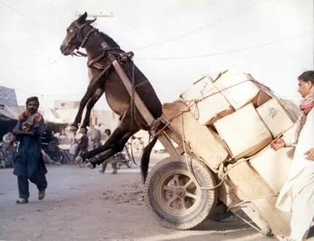

Slide 3

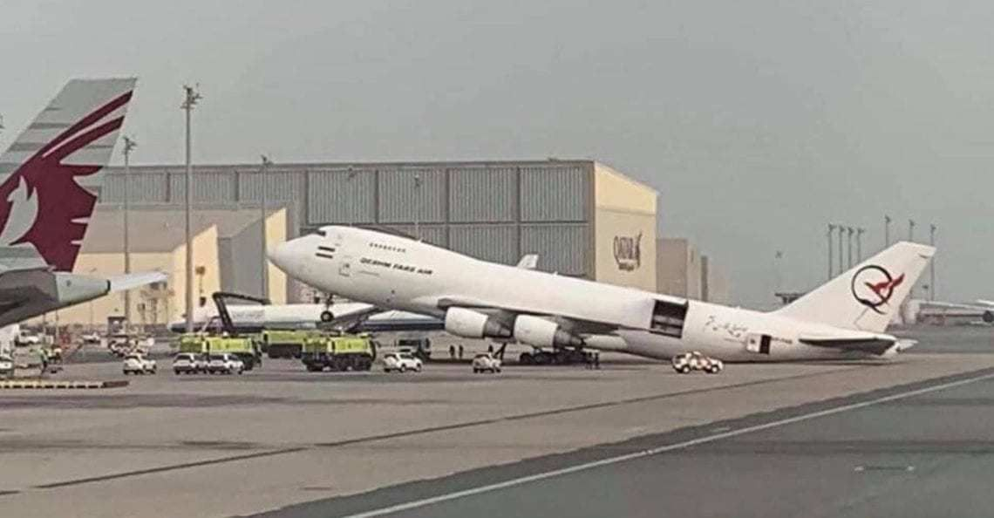

Slide 4
Human Factors – Organisational Aspects
"New View" (Dekker, Hollnagel)
Human error is often result of problems deeper in system
Errors are acknowledged
Errors are result of people doing normal work in normal situations, connected to features of tools, tasks, procedures and environment
Focus on explanation of incidents/accidents – not immediate judgement
Human Error is Human Behaviour
"Work done" vs "Work imagined" (Piper Alpha Disaster)
Human Error is systematically connected to people's tools,
tasks and operating environment

Slide 5
MANAGING THREATS
AVOID TRAP MITIGATE
Maintain a high degree of Situational Awareness.
Notice, understand, think ahead.
The effects of threats occur in the future and so may be trapped or mitigated by planning ahead.
Threats are not Errors, but they increase the potential for error..

Slide 6
DEFINING ERROR
An error may be defined as:
A consequence of human involvement which causes deviation from crew or organisational intentions or expectations.
Errors may occur either in the presence or absence of Threats..

Slide 7
LOSA (Line Ops Safety Audit) data- ERRORS
Error Frequency
Handling Errors
75% of flights had 1 or more Errors.
36% of all errors. Most common- unintentional speed deviation – SIDS and STARS
The average number of Errors/flight was 2.6.
Procedural Errors
Communications Errors
52% of all errors. Most common- checklist from memory.
12% of all errors. Most common- missed ATC calls.
Mainly crews failed to respond to errors once committed, many turned into Undesired Aircraft States (UAS) but crews were successful in mitigating the consequences

Slide 8
UAS – TEM (Threats and Errors Management)
Threats that are not managed and then lead to errors can result in Undesired Aircraft States.
These are situations such as an aircraft that is too fast or too low on approach (unstabilised approach) or too close to the ground (incorrect flight plan) that can lead to an accident.
The aircraft is not in the correct state for the situation.
TEM applies to ground operations, ATC, and support operations where threats and errors can result in undesired states in all aspects of the operation.
Undesired states in any aspect of aviation may ultimately impact safety of flight and ground operations.

Slide 9
The Individual – Information Acquisition and Processing
Attention.
To pay attention to something is to concentrate on it.
Attention is limited; if we use some attention, we cannot use it for something else.
Huge amounts of data enter our senses but only a small amount gets our attention
Selective attention is the ability to focus our attention on one source all the time
Active listening requires conscious attention
Look at the following short video and answer the question (CTRL + left click)

Slide 10
HUMAN ERROR
In general, Error is when humans get something wrong; forgetting something, an incorrect action or a bad decision.
The new view is that Human Error is systematically connected to people's tools,
tasks and operating environment

Slide 11
"Defence in Depth"
A key concept associated with error management is that of "defence in depth", based on the premise that there are many stages in any system where errors can occur, and similarly many stages where defenses can be built to prevent and trap errors.
Examples of defenses are pre-flight checks, automatic warnings, challenge-response procedures, etc. which help prevent and 'trap' human errors, reducing the likelihood of negative consequences. It is when these defences are weakened and breached that human errors can result in incidents or accidents.
These defenses have been portrayed diagrammatically, as several slices of Swiss cheese

Slide 12
Swiss cheese model
A threat model of cheese does not refer to the food itself but to the Swiss Cheese Model, a risk management framework where layers of defense (slices of cheese) contain holes (weaknesses); threats are neutralized by multiple layers, as a single flaw in one layer can be blocked by the next, preventing a complete system failure. This model is applied across various sectors like aviation, healthcare, and cybersecurity to visualize and mitigate potential failures in safety-critical systems.
How the Swiss Cheese Model Works
Layers of Defense
Holes as Weaknesses
Each slice of Swiss cheese represents a different layer of security or safeguard, such as a physical barrier, a procedural control, or a technological tool.
The holes in each slice symbolize weaknesses or potential failures within that specific layer.
Alignment of Holes
Layered Protection
An accident or failure occurs only when the holes in multiple layers align, creating a clear pathway for the threat to pass through all defenses.
By having multiple, imperfect layers, the likelihood of the holes aligning and a threat succeeding is significantly reduced.

Slide 13
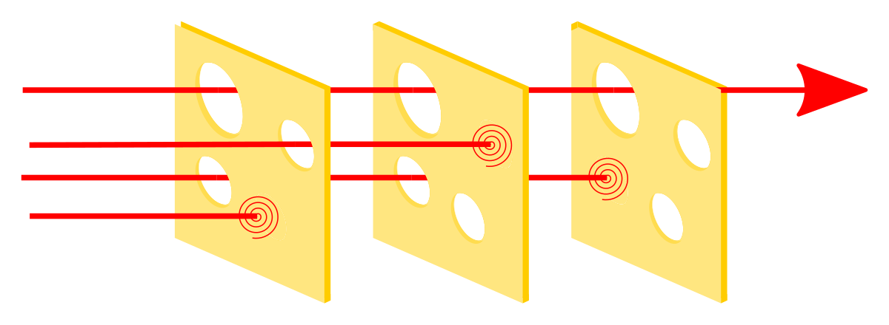
Swiss cheese model

Slide 14
The Individual – Situational Awareness (SA)
Most people would think of awareness as being alert and paying attention to what is going on around them.
Situational awareness in a complex environment like aviation also involves having knowledge of something in advance of the event, not just being alert in the present.
A practical definition of SA for aviation might be:
When a person is able to anticipate how a situation is likely to continue into the future
This is why there are growing links between TEM (Threats and Errors Management) strategies and SA – for example a focus on threats in ground and flight briefings to understand what might happen in the future and be aware and plan for it.
Situational Awareness is creating a Shared Mental Model (mental picture) through effective communication and projection into the near future
The most important part of sharing Situational Awareness is - Effective communication

Slide 15
The Individual – Decision Making (DM)
Rational Decisions
As we've seen in info. processing and human error, pressure to think in an unusual or emergency situation will not assist rational decision making, as workload may very quickly increase.
Many operators use aids to decision making as a way of reducing workload – much like a checklist.
The steps in rational decision making: Detect information; recognise; diagnose; determine alternatives; risk assessment; act
Airlines have developed a decision making tool for crews along these lines – a popular one is T-DODAR.

Slide 16
The T-DODAR Steps
1
T ime
Quickly assess the available time and situation to determine the urgency of the decision.
2
D iagnose
Identify the specific problem or issue at hand using available information and instruments.
3
O ptions
Generate potential solutions or courses of action to address the identified problem.
4
D ecide
Select the best option from the available choices after evaluating their pros and cons.
5
A ssign
Delegate specific tasks related to implementing the chosen decision to the crew members.
6
R eview
Continually monitor the situation and the effectiveness of the implemented actions, making adjustments as needed. Significance in Aviation

Slide 17
COMMUNICATION AND LEADERSHIP

Slide 18
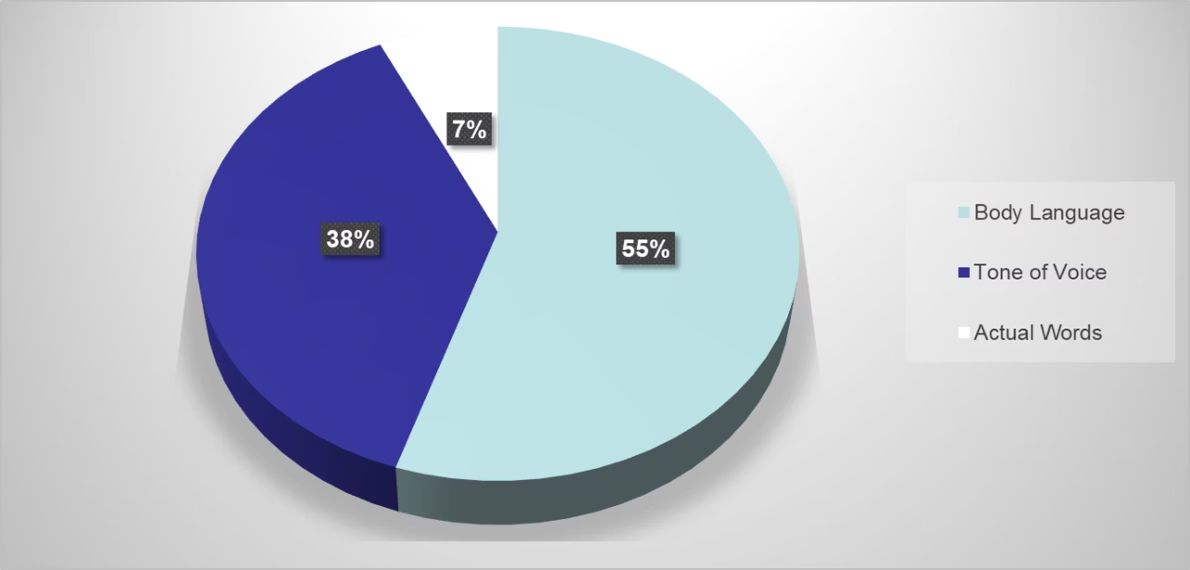
Elements of Communication
The 7-38-55% Rule indicates that only 7% of all communication is done through verbal communication, the words we speak, whereas the nonverbal component of our daily communication, such as the tonality of our voice, make up 38% and 55% from the speaker's body language and facial expressions.
The meaning of a message we transmit is mostly determined by Non Verbal; has the greatest meaning
Para linguistic communication is intonation of the voice

Slide 19

Communication
"The greatest enemy of good communication is the illusion of it !"

Slide 20
Communication
"Over 70% of all accidents reports involves some kind of oral communication problem"
ICAO doc 4444 ATC
( ch .Phraseology )

Slide 21


ACTIVE LISTENING
it is part of communication - all members are responsible.
results in:
better communication, safety, efficiency,
improved relationships, decision-making and harmony

Slide 22
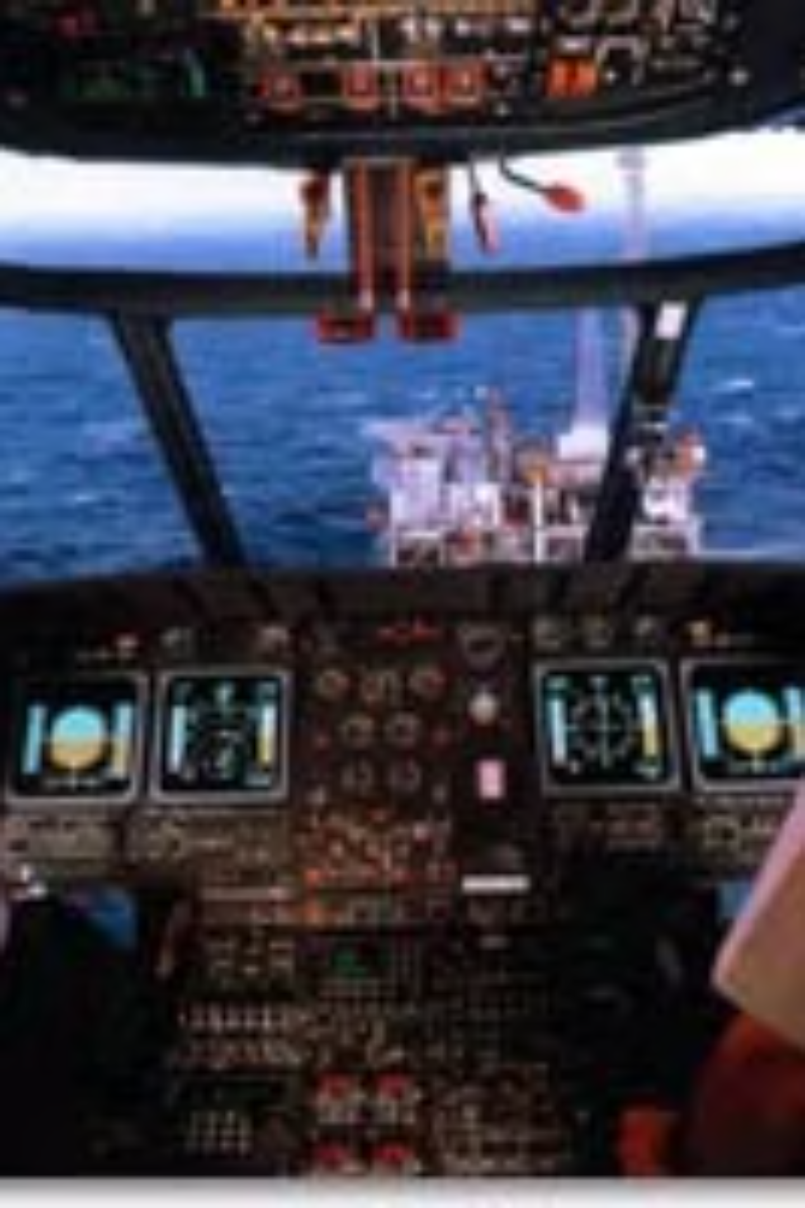
Areas of Communication
Crewmembers/ office day by day
Air traffic control
Other Aircraft
Passengers
Aircraft itself (MCP, FMA)

Slide 23

Types of Communication
Operating procedures (OM)-SOP (example)
Leadership communication
Inappropriate communication

Slide 24
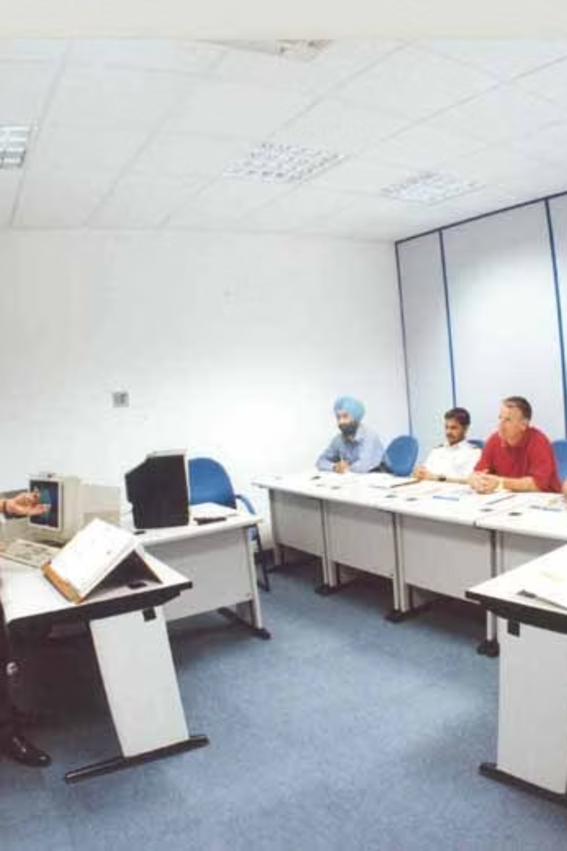
Communication - Briefings
There are three main aspects of a good briefing:
It should be interactive - a two or three way communication
It should be relevant to the current situation - dealing with relevant issues
It should be closed loop so that the concepts are mutually
understood and agreed upon

Slide 25

Communication Tools
Call-outs-80 Kn
Challenge & Response
Closed Loop

Slide 26
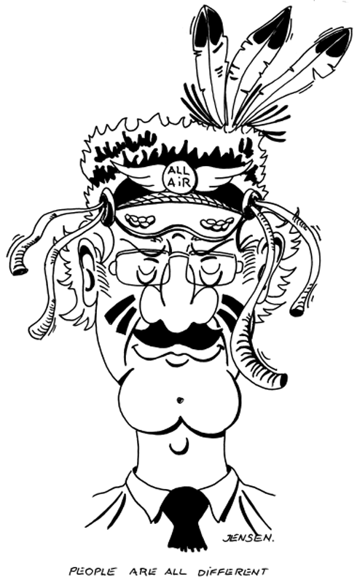
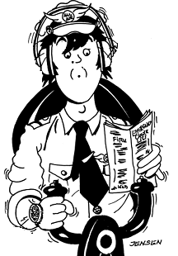
Communication – Closed Loop
3. Confirmation
1. Message
Transmitter
Receiver
2. Feedback

Slide 27
Communication – Barriers
TRANSMIT
RECEIVE
RECEIVE
TRANSMIT
Examples:
1
2
Multiple or simultaneous communication
Language, terminology, non standard phraseology,
3
4
Hearing problems, reduced mental capacity
Mentally absence due to personal terms

Slide 28

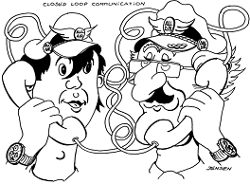
Communication - Message
Use correct terminology/expressions
Use correct OM language
Timing of the message

Slide 29
Communication Challenges
Transmittal Challenges
Form your ideas and thoughts as simple as you can
One idea at the time
Use correct "voice" for the situation
Repeat if necessary
Avoid distractions
Give feedback

Slide 30




Communication Challenges
Receiver Challenges
Background noise
Multiple communication sources
Mindset and expectance factors
Confirm 'unclear' messages

Slide 31
SUPERIOR-SUBORDINATE COMMUNICATION HAVE BOTH A FORMAL AND INFORMAL COMPONENT
Formal
Informal
job instructions
about subordinate himself or herself
job rationale
about coworkers and their problems
organizational procedures and practices
about organizational pol. and prac.
feedback about subordinates performance, and
about what needs to be done and how it can be done
indoctrination of goals-Target

Slide 32
Regulating Information Flow
The leader(Capt) must regulate, manage and direct the flow of information, ideas and suggestions within the crew members and outside sources
Communicating flight information
Asking for opinions, suggestions-British Mid crash 1989
Giving opinions, suggestions
Clarifying communication
Providing feedback
Regulating participation

Slide 33

Directing and Coordinating Crew Activities
The leader must function as crew manager to provide orientation, coordination and direction for group performance
Directing and coordinating crew activities
Monitoring and assessing crew performance
Providing planning and orientation
Setting priorities

Slide 34
Motivating Employees / Crew Members
The leader must maintain a positive climate to encourage good crew member relations and to invite full participation in crew activities
Creating proper climate-team bildind
Maintain an "open" cockpit atmosphere
Resolving/preventing angry conflict
Maintain positive relations
Providing non-punitive critique and feedback

Slide 35
GIVING FEEDBACK
1
It must be Descriptive
5
appropriately timed
2
be useful
6
contain an offer to help
3
specific and factual
7
have a plan from then on
4
resent

Slide 36
TIPS
Never begin feedback with the
word YOU because:
YOUR MESSAGES FAIL TO INFLUENCE PEOPLE TO CHANGE THEIR UNACCEPTABLE BEHAVIOUR
make people feel guilty.
are experienced as put downs, rejection or criticism.
communicate a lack of respect for the other person.
damage another's self-esteem.
produce resistance.

Slide 37

"I" MESSAGES
show your concern regarding the other person's behavior
allow you to provide the feedback in a non-threatening manner
allow you to focus on the tangible and concrete EFFECT or CONSEQUENCES of the behavior
example: "When the report is late? I am really disappointed, because then I cannot submit my recommendations on time."
REMEMBER: No one can change another person's behavior. Only they can change behavior if they choose to.

Slide 38
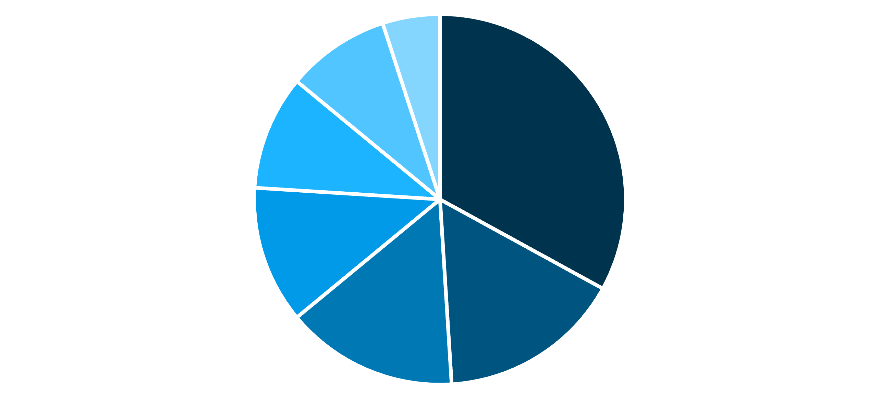
СOMMUNICATION PROBLEMS THAT LED TO ACCIDENTS
Problems related to crew coordination
Lack of conversation control
Info. Believed to have been transmitted
Total lack of communication
Complacency
Miscellaneous communication
”misfires”
Lack of confidence in Subordinates

Slide 39
IMPORTANCE OF "ACTIVE" LISTENING
01
02
03
It is a basic human need to be heard and understood – active listening serves that need.
Active listening is a skill that can and must be learned.
In an emergency or crisis, active listening is a critical skill.
04
05
Enhances communication, eliminates barriers, improves relationships.
Effective leaders: one common element or trait was the leader's ability to actively listen.
Not just to hear but to UNDERSTAND

Slide 40

CAUSES OF POOR LISTENING
Failure to remember that listening is a part of the Two-way Process.
Evade what is difficult or unwelcome.
Impatience. – "projecting"…leads to misunderstanding and every often wasted effort on the part of the listener.
Low rating of the other person.Exp Capt+Y FO
The emotional state of the listener.

Slide 41






HOW TO LISTEN ACTIVELY
ECHO
REFORMULATION
OBSERVATION
REINFORCEMENT
EYE CONTACT
BODY POSTURE

Slide 42
TEMWORK
Problems of leadership and loss of proper employees //crew coordination have been specifically identified as causal or contributing factors in numerous incidents and accidents. i.e.
Lack of support
S.O.P'S ignored
Stress Problems
Judgment problems
Emotional problems
Get-home-it is

Slide 43
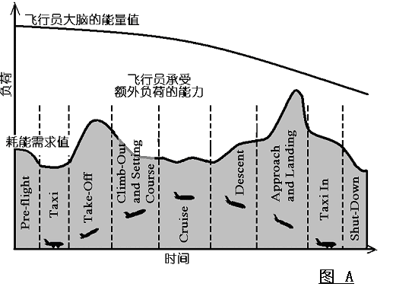
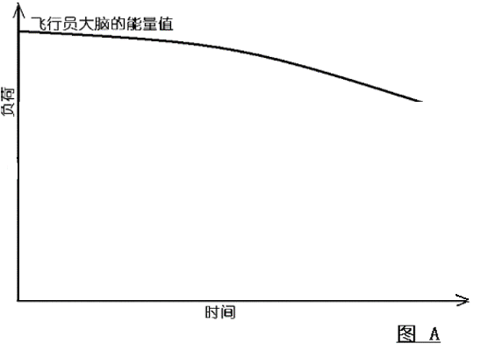
cl
Pilot’s ability
LOAD
Extra load performance
Performance requirements
TIME

Slide 44
Errors by Phase of Flight
Phase of Flight
Errors by Phase
Mismanaged Errors
Pre-Departure / Taxi
24%
18%
Takeoff / Climb
22% 4 min
16%
Cruise
6%
17%
Descent / Approach / Land
44% 8 min
35%
Taxi / Park
4%
24%

Slide 45
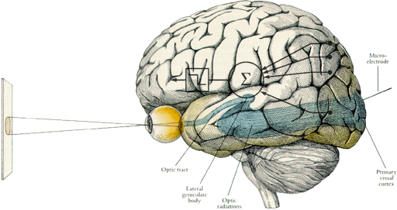
Human brain working function
Single-channel Decision Making
OUTPUT
INPUT

Slide 46
Incident (Accident)
Threat
Crew Error
Undesired Aircraft
State
Result of mismanaged threat and error
Incident
"the tip of the iceberg"

